Slide 1
Deepanshu Joshi (153004) Shivani Katolkar(152994) Vignesh R(152978) Kavya S V(153046)
Training Room 4
Capgemini MIPL
Chennai

Slide 2
FLP PROJECT 2018
Training Room 4
Capgemini MIPL
Chennai
21st August 2018

Slide 3
CapStore
Notes:
Usar para separador de capitulos . Seria bom ter esta versao em vermelho e verde tb..

Slide 4
Modules Assigned:
sign up & activation (Module 1)
Login/Logout/session (Module 2)
Admin page/Admin Profile (Module 3)
Merchant Page/Merchant Profile (Module 4)
Customer Page/Customer Profile (Module 5)

Slide 5

Roles and Responsibilities
Notes:
O Logo de espadas deve ter mais espaço das pontas abaixo. Sugerir outros tipos de imagens/ telefone, fones.

Slide 6
Module 3: Admin Page/Profile
The functionalities present in this module are :
1.Front End designing of the admin page.
2.Importing Customer, Merchant and Inventory details.
3.Filtering and Displaying the details according to specific customers and merchants.
4.Adding additional functionalities as links, as per the requirements in other modules.
Notes:
O Logo de espadas deve ter mais espaço das pontas abaixo. Sugerir outros tipos de imagens/ telefone, fones.

Slide 7
Tables Used
Customer
Merchant
Inventory
Brand
Category

Slide 8
Tables :
Customer Table
Column Name | Data type | Constraint | Description
customerId | int | Primary key Auto Generated | Used for unique identification
customerName | varchar | NotNull
phoneNumber | int | NotNull
emailId | varchar | unique | Will be Used for user Login
Dob | Date | NotNull
Password | Varchar | NotNull | Authentication purposes
Address | varchar | Foreign Key
Status | Varchar | NotNull | To let know if user is active or not
Notes:
Fixar a posicao do titulo – sempre do lado esquerdo.
Sempre que tiver muito texto o coluna deve sempre ser “ narrowed” , se nao fica dificil de ler. Colocar paragrafos no texto.
Linha vertical deve ser mais fina e as pontas NUNCA devem ser arredondadas.

Slide 9
Merchant Table
Column Name | Data type | Constraint | Description
merchantId | int | Primary key Auto Generated | Used for unique identification
merchantName | varchar | NotNull
phoneNumber | int | NotNull
emailId | varchar | unique | Will be Used for merchant Login
companyName | varchar | NotNull
Password | Varchar | NotNull | Authentication purposes
Address | varchar | Foreign Key
Status | Varchar | NotNull | To let know if user is active or not
isCertified | Boolean | NotNull | Is the Merchant CapStore Certified or Not
isValidated | Boolean | NotNull | Is the Merchant CapStore validated by admin or not
Notes:
Fixar a posicao do titulo – sempre do lado esquerdo.
Sempre que tiver muito texto o coluna deve sempre ser “ narrowed” , se nao fica dificil de ler. Colocar paragrafos no texto.
Linha vertical deve ser mais fina e as pontas NUNCA devem ser arredondadas.

Slide 10
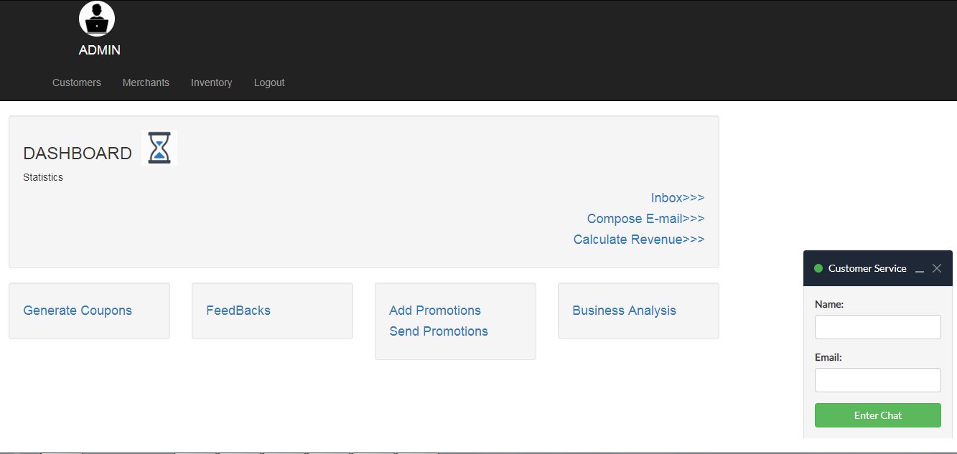
Admin Page Dashboard

Slide 11
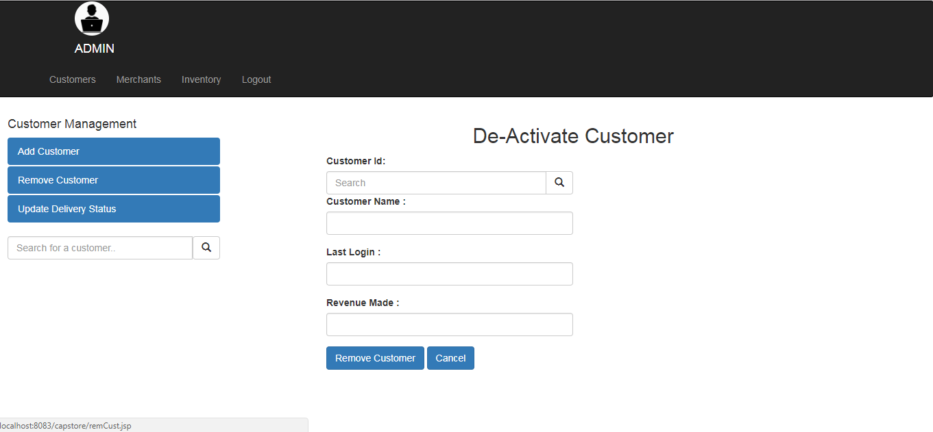
Customer Page

Slide 12
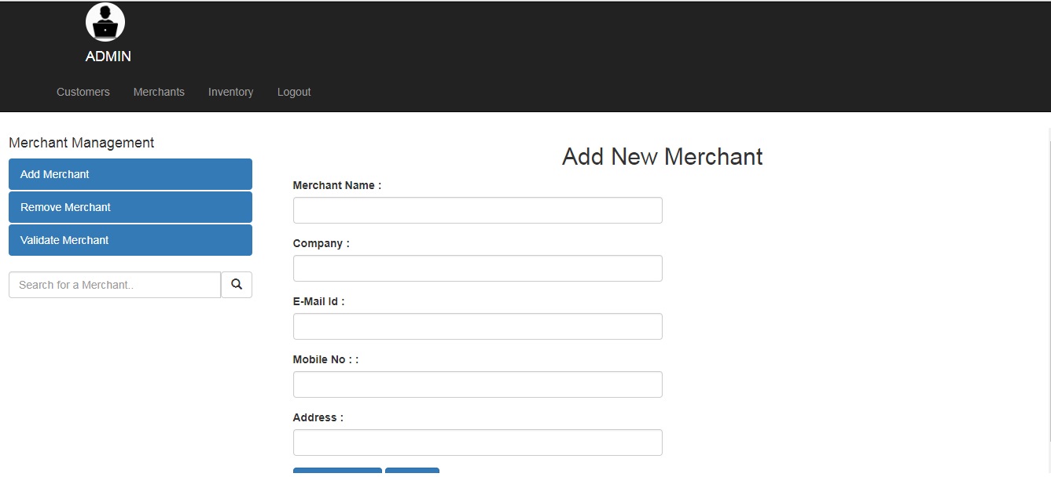
Merchant Page

Slide 13
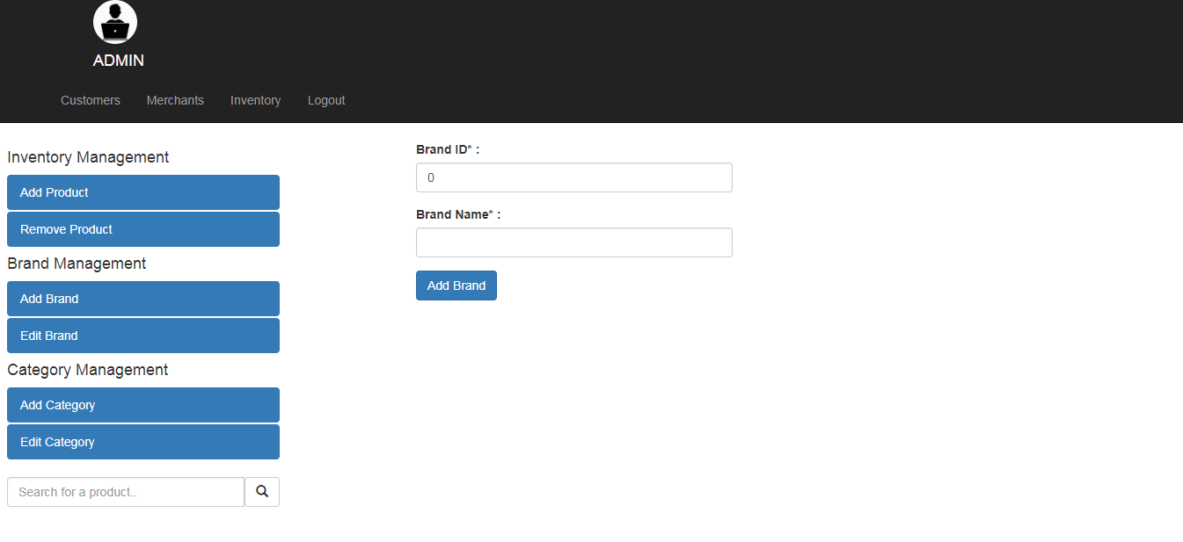
Inventory Page

Slide 14
Thank you
Notes:
O Box atras do texto desnecessario. Deixar o layout mais simples.

